Slide 1
Computing human society through the global news
The SBP 2014 Grand Data Challenge
Kevin S. Xu
Wen Dong
Fred Morstatter
Katherine Chuang

Slide 2
Using news media to understand society
Global news media has long been used as a key archive of human society
Massive explosion in availability of global news presents great opportunities for computing human society at a global scale and fine resolution
Global Database of Events, Language, and Tone (GDELT) is an initiative to construct a quantitative catalog of societal-scale behavior and beliefs across the world

Slide 3
The GDELT data set
GDELT data set contains nearly a quarter-billion geo-referenced dyadic event records that capture global behavior covering 1979 to present
“Who did what to whom, when, and where”
Events captured in taxonomy of over 300 categories of global political behavior from riots and protests to diplomatic exchanges and peace appeals
Event records geo-referenced to city level and updated daily

Slide 4
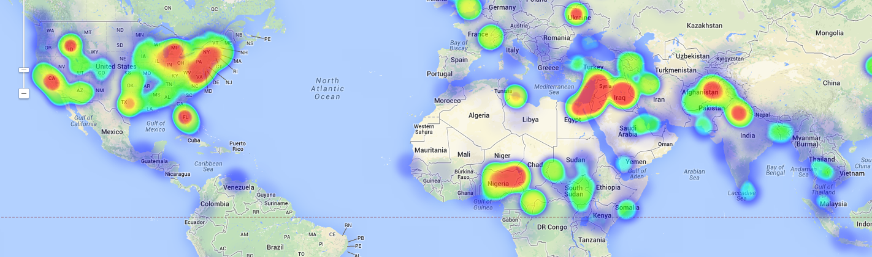
SBP 2014 Grand Data Challenge Problem
How do we synthesize and integrate the rapidly increasing pace and volume of global news data to understand human society?
SBP 2014 Grand Data Challenge invites participants to explore the GDELT data set to address various aspects of this problem

Slide 5
Evaluation of submissions
Submissions evaluated by an interdisciplinary panel of judges who perform research in SBP or closely related areas
Submissions evaluated on
Novelty
Scientific rigor
Quality of presentation
Expected impact to the SBP community

Slide 6





Submitted entries
Amirjavid, F. & Adda, M. | Data-Driven Modeling and Analysis of Simultaneous Plans Case Study: Behavior Prediction of Human Societies on GDELT dataset
Yoshioka, M. & Kando, N. | Comparative Analysis of GDELT Data Using the News Site Contrast System
Durante, D. & Dunson, D. B. | Friends in Joy and Sorrow: an Analysis of 2007-2012 Global Financial Crisis via Bayesian Nonparametric Dynamic Networks
Phua, C., Feng, Y., Ji, J. & Soh, T. | Visual and Predictive Analytics on Singapore News: Experiments on GDELT, Wikipedia, and ˆSTI
Jiang, L. and Mai, F. | Discovering Bilateral and Multilateral Causal Events in GDELT

Slide 7
Judges
Don Adjeroh
Professor, Lane Department of Computer Science and Electrical Engineering, West Virginia University
Nathan Bos
Senior Research Scientist, Applied Physics Laboratory, Johns Hopkins University
Jürgen Pfeffer
Assistant Research Professor, School of Computer Science, Carnegie Mellon University
Winter Mason
Data Scientist, Facebook

Slide 8
Runner-up of SBP challenge
Selection of comments from judges
“The idea of using the GDELT dataset to identify Granger-causal relationships between countries’ events is a good one, and showing that using multiple relations improves prediction is also good.”
“Interesting approach comparing multiple time series.”
“Would like to see it more broadly applied to GDELT data.”

Slide 9
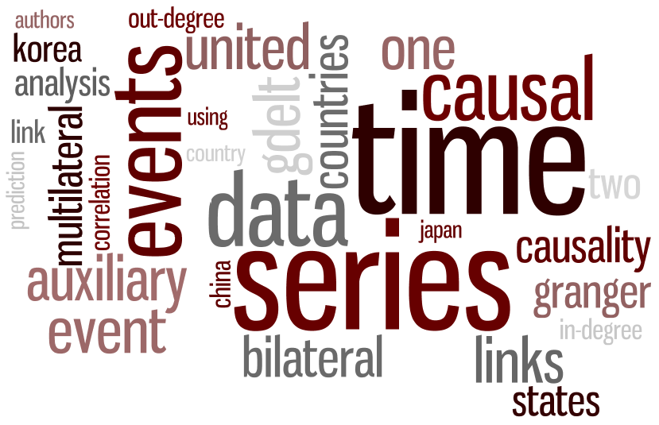
Discovering Bilateral and Multilateral Causal Events in GDELT
Lei Jiang
Tapjoy, Inc.
Fan Mai
University of Virginia

Slide 10
Winner of SBP challenge
Selection of comments from judges
“The results showed the importance of effective communication between countries (as encoded in GDELT) in dictating the pace and direction of the world financial markets, when compared with material exchanges between the countries.”
“The method used is a quite rigorous approach with appropriate priors and inferences for time series data. The insights gained are interesting.”
“Technically rigorous paper. Not sure what we’ve learned.”

Slide 11
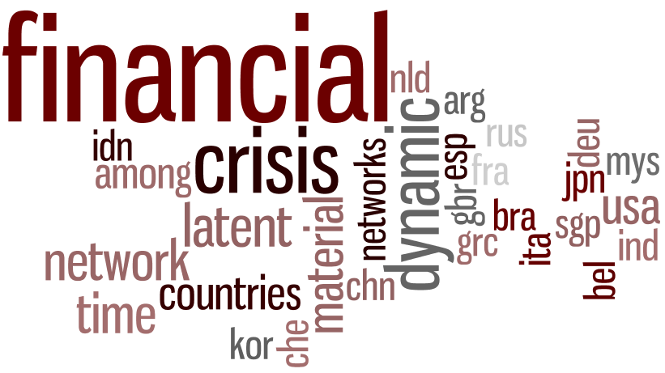
Friends in Joy and Sorrow: an Analysis of 2007-2012 Global Financial Crisis via Bayesian Nonparametric Dynamic Networks
Daniele Durante
University of Padua
David B. Dunson
Duke University

Slide 12
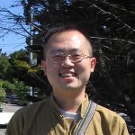
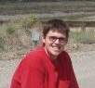
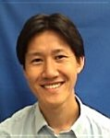
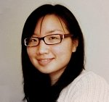
SBP 2015 challenge
SBP will run another challenge problem in 2015
Please contact SBP 2014 challenge co-chairs with suggestions on interesting problems and data sets relevant to the SBP community!
Kevin Xu
Wen Dong
Katherine
Chuang
Fred
Morstatter

